Slide 1
It’s Time to Automate Your Database Changes
JFrog swampUP 2020
Robert Reeves, CTO
@robertreeves

Slide 2
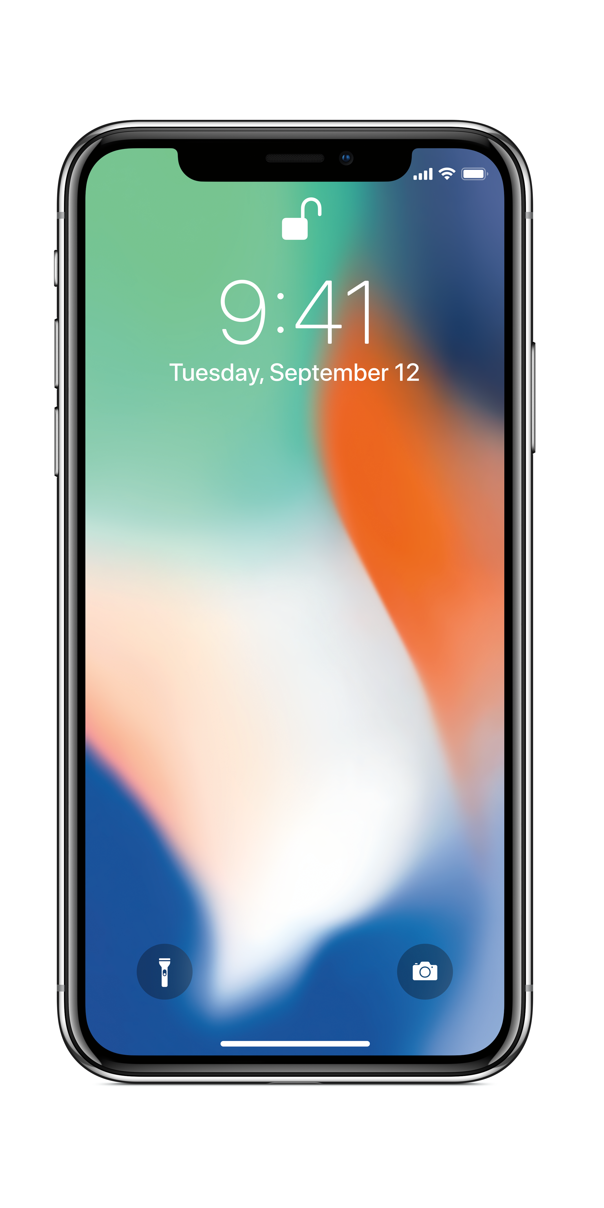

Slide 3
Application Releases
# of Releases
Deployment Gap
Database Deployments
Time

Slide 4


Slide 5
How did we get into this mess?

Slide 6
1979

Slide 7


Slide 8
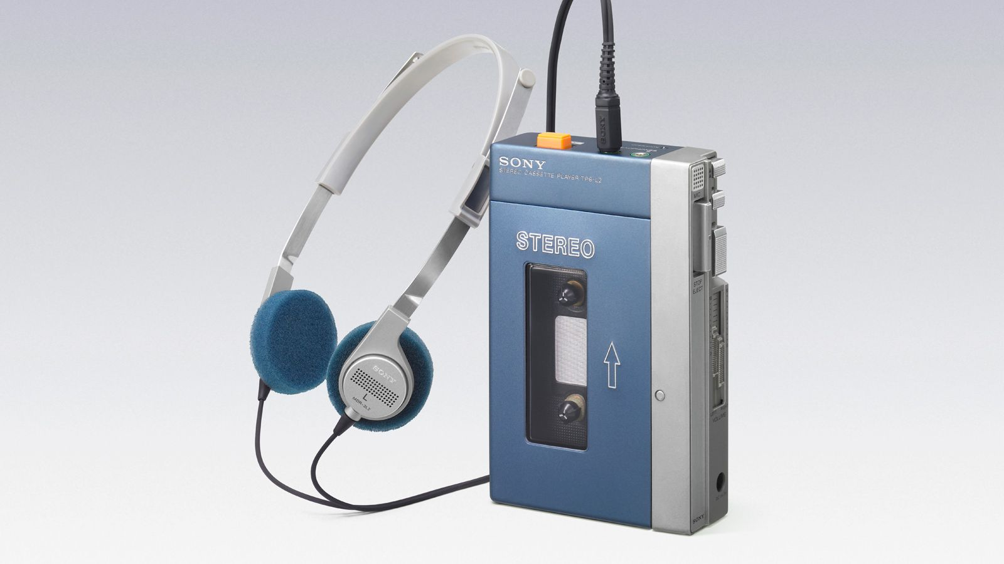

Slide 9
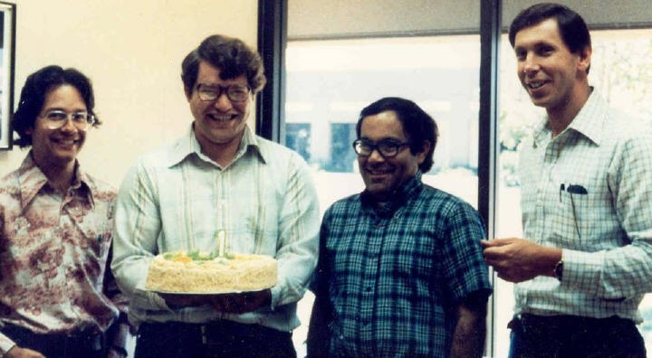

Slide 10
2002

Slide 11


Slide 12
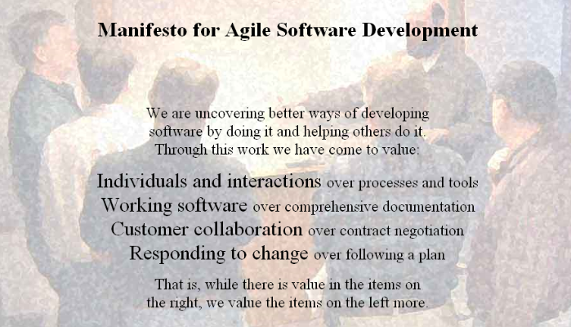

Slide 13


Slide 14
2009

Slide 15


Slide 16
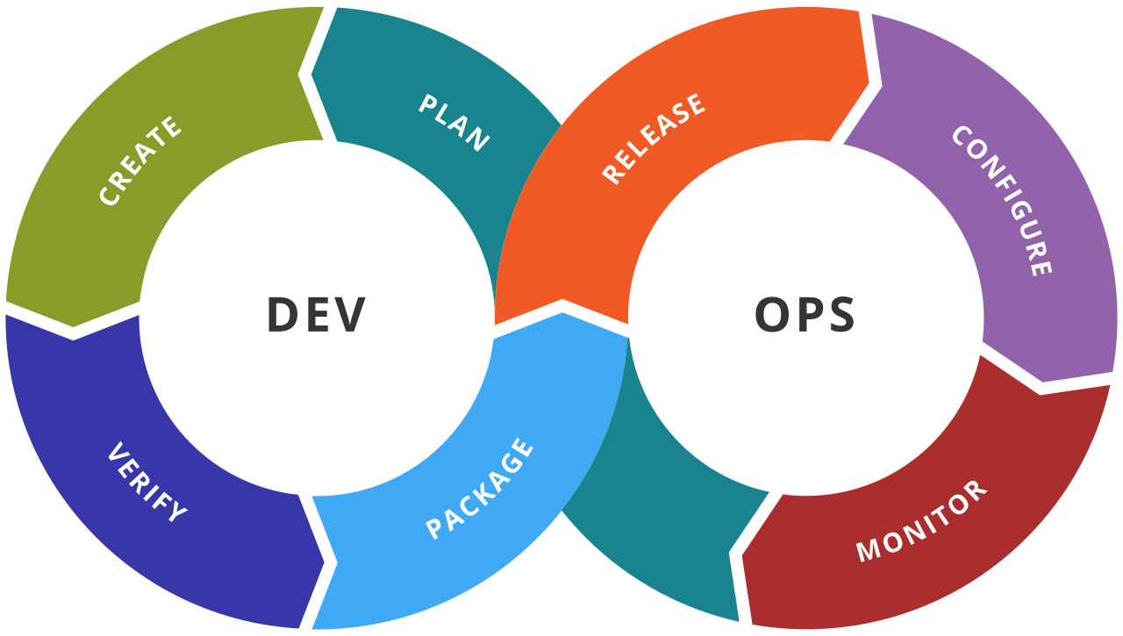

Slide 17


Slide 18
“The future is already here;
it's just not very evenly distributed.”
--William Gibson

Slide 19
The Reason We Haven’t Fixed the Database CI/CD Problem…

Slide 20
“We’ve always done it that way.”

Slide 21
Here are some things we used to do, too:

Slide 22
Leaches & Bloodletting

Slide 23
Asbestos

Slide 24
Smoking

Slide 25
Creating a Ticket to Change the Database Schema

Slide 26
5 Ways to Clean This Mess Up

Slide 27
#1
You are not “done” until it’s in Production.

Slide 28
#2
No more tickets for database changes.

Slide 29
#3
Development must enforce good database standards.

Slide 30
#4
Leave it better than you found it.

Slide 31
#5
Team Work
makes the
Dream Work.

Slide 32
Reddit: /r/Liquibase
Stack Overflow (tag: Liquibase)
@Liquibase
@robertreeves

